Slide 1
Nuclear Physics: An Engineering Perspective
Part III: The Fun Stuff

Slide 2
Nuclear Reactions
So far, we’ve talked about radioactive decay
Some isotopes are unstable, and will decay to other isotopes with a certain probability (the half-life)
There’s not much that can be done about this
Notes:
Some of these isotopes are unstable, and they will decay to other isotopes in ways that we’ve talked about, alpha and beta decay. They have a certain characteristic period, called the half-life, which is a time period in which each atom has a 50/50 chance of decaying. And there’s not much that can be done to change this. As you’ve seen, I have a 0.1 microcurie sample of polonium-210, or at any rate, I have a sample of polonium-210 that was 0.1 microcuries when it was created, and it undergoes alpha decay with a half-life of 138 days. Now, I could take that sample and heat it until it boils, or cool it to near absolute zero, or compress it, or react it with other chemicals to form compounds, and from a nuclear physics point of view, it’s unaffected; it will still undergo alpha decay with a half-life of 138 days.

Slide 3
Nuclear Reactions
How can we cause changes to atoms?
The main way to intentionally modify atoms starts with adding one or more neutrons.

Slide 4

Nuclear Reactions
Example: We start with ${}_{79}^{197}{Au}$
This is normal, stable gold
Then we fire a neutron at it!
Suppose the neutron gets captured by the ${}_{79}^{197}{Au}$ nucleus
The probability of this depends on the neutron cross section
(Roughly, how big the nucleus “looks” to the neutron)
Notes:
Okay, so let’s look at an example. We’ll start with gold-197, which is normal, stable gold that you dig out of the ground.

Slide 5

Nuclear Reactions
We have now produced ${}_{79}^{198}{Au}$!
${}_{79}^{197}{Au}+{}_{0}^{1}n→{}_{79}^{198}{Au}+ γ$
This is an unstable isotope of gold

Slide 6
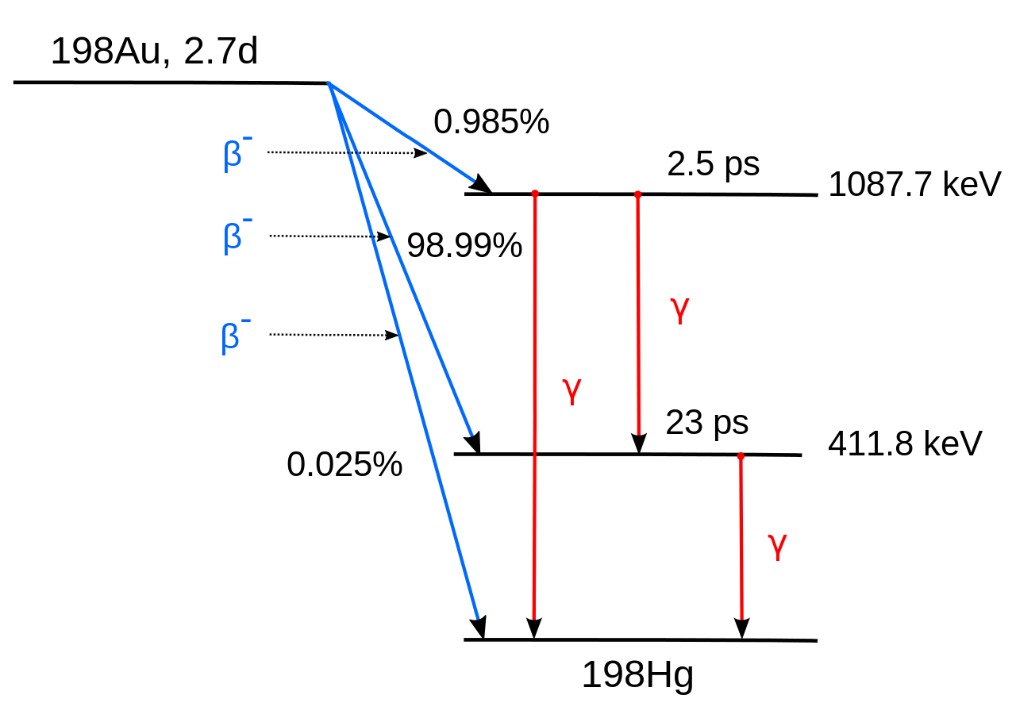
Nuclear Reactions
https://commons.wikimedia.org/wiki/File:Au-198_Decay_Scheme.svg Public Domain Daveturnr

Slide 7

Nuclear Reactions
This is extremely powerful
Through the use of neutrons, we have:
Turned stable gold into radioactive gold
Eventually turned gold into an entirely different element $\left({}_{80}^{198}{Hg}\right)$
You can’t do that in chemistry!
Conclusion: in nuclear reactions, neutrons are everything

Slide 8

Fission
In fission, a nucleus of a heavy isotope splits into two lighter isotopes
Releases fission products + neutrons + energy
Fission can happen naturally (spontaneously) to some heavy isotopes, like ${}_{98}^{252}{Cf}$

Slide 9
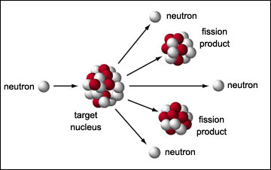
Neutron-Triggered Fission
More commonly, fission happens when a large nucleus gets hit by a neutron
This results in:
Daughter isotopes (fission products)
Neutron(s) (usually)
https://www.atomicarchive.com/science/fission/index.html

Slide 10
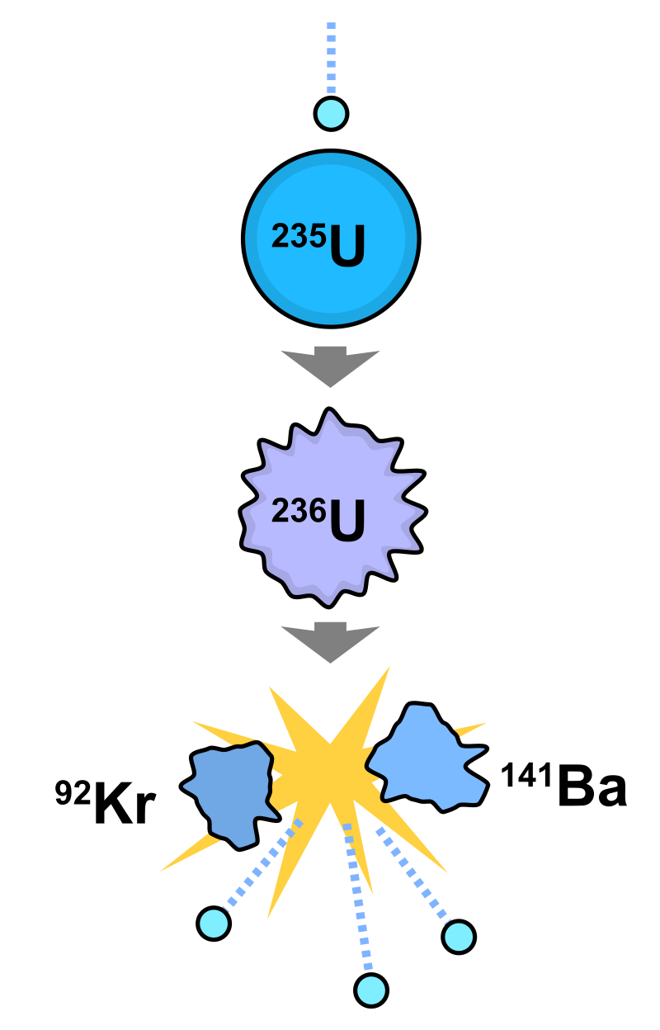

Case Study: U-235
${}_{92}^{235}U+ {}_{0}^{1}n→$
$${}_{56 }^{141}{Ba}+{}_{36}^{92}{Kr}+3 {}_{0}^{1}n+203 MeV$$
We get out more neutrons than we put in!
https://commons.wikimedia.org/wiki/File:Nuclear_fission.svg
Public Domain
Fastfission

Slide 11
Case Study: U-235
Suppose each of those 3 neutrons hits another U-235 atom…
After this second stage, you have 9 neutrons flying around, and a total of 810 MeV of energy released
Each of the 9 neutrons hit more U-235 atoms, etc.
This is called a chain reaction

Slide 12

Case Study: U-235
202.5 MeV, the energy from one U-235 fission, is about $3.2⋅{10}^{−11}$ Joules
Doesn’t sound like a lot…
But that is per atom

Slide 13
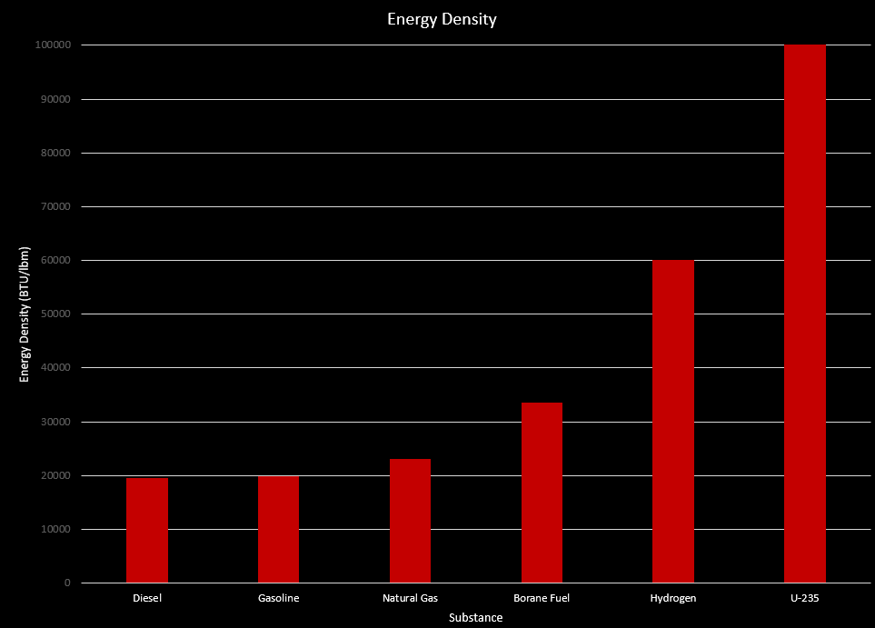
Case Study: U-235
Notes:
32 mi

Slide 14
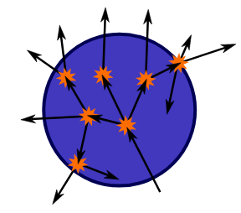
Criticality
Subcritical: most of the neutrons escape without hitting U-235 nuclei
On average, < 1 neutron from each fission causes another fission (k<1)
Rate of fissions declines over time
k=0.85
https://commons.wikimedia.org/wiki/File:Critical_mass.svg
Public Domain
Fastfission

Slide 15
Criticality
Critical: on average, 1 neutron from each fission causes another fission (k=1)
Rate of fissions is constant

Slide 16
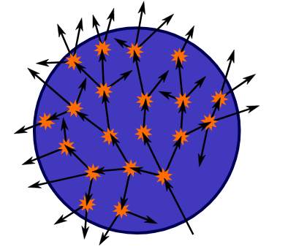
Criticality
Supercritical: on average, > 1 neutron from each fission causes another fission (k>1)
Rate of fissions increases over time
k=1.12
https://commons.wikimedia.org/wiki/File:Critical_mass.svg
Public Domain
Fastfission

Slide 17
Criticality
A sphere is the optimal way to group atoms to achieve maximum k
A larger/denser sphere increases k
Greater mass-to-surface area ratio
For a given fissile material, a sphere just large enough to sustain a critical fission process is called the critical mass
For U-235, this is about 115 lb

Slide 18
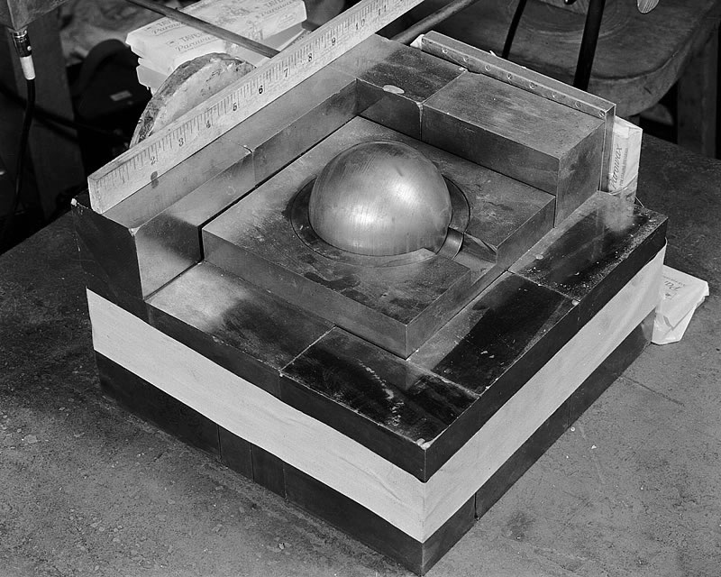
Criticality
We can achieve criticality with less mass by surrounding the fissile material with neutron reflectors
These are materials the reflect escaping neutrons back into the core
Public Domain
LANL

Slide 19
Criticality
Bombs
Power Reactor
Goal: release as much energy as possible
Make the reaction very supercritical
Keep it together as long as possible
Eventually, the released energy blows the core apart, and the reaction stops
Goal: slowly release controllable energy
Generally stay around k=1
k < 1 to shut down
k > 1 to start up
Control rods used to control reactions
Neutron absorbers stuck into core

Slide 20
Further Study
DIY nuclear physics experiments
https://www.youtube.com/watch?v=uQ8vwevCq8Q
https://www.youtube.com/watch?v=RKyIm-o30GE
Scott Manley series on nuclear weapons
https://www.youtube.com/watch?v=pWWjbnAVFKA (Part 1)
Scott Manley on Chernobyl physics
https://www.youtube.com/watch?v=q3d3rzFTrLg

